Slide 1
Getting Git
Dr. Scott Nykl
CSCE593
!!!NOTE: Replace “486” with “593” for the remainder of these slides!!! This course is csce593!

Slide 2
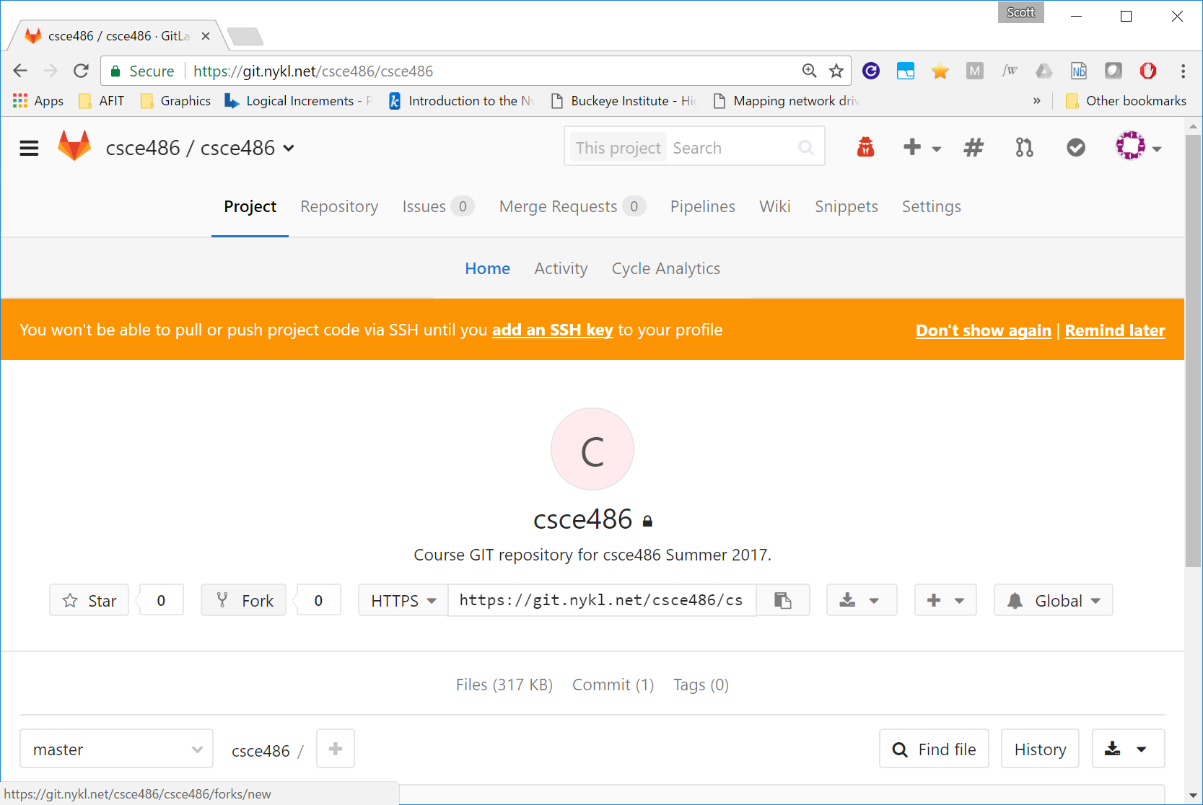
Fork csce593/csce593

Slide 3
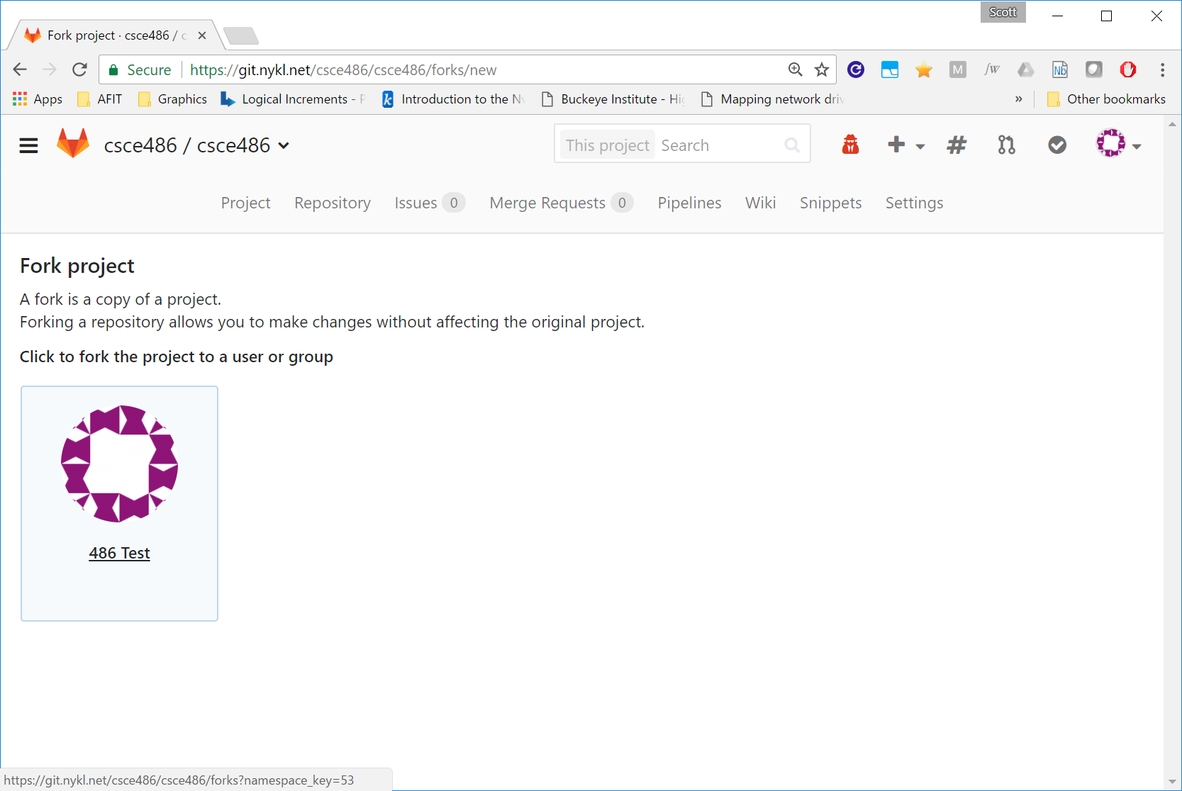
Confirm Fork

Slide 4
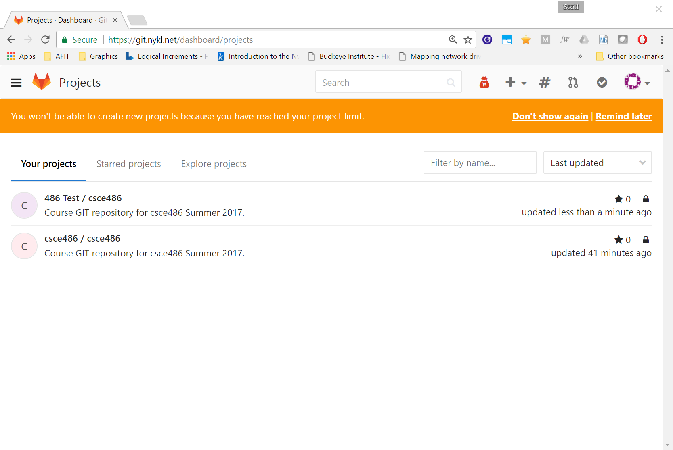
Now 2 Projects Exist!

Slide 5
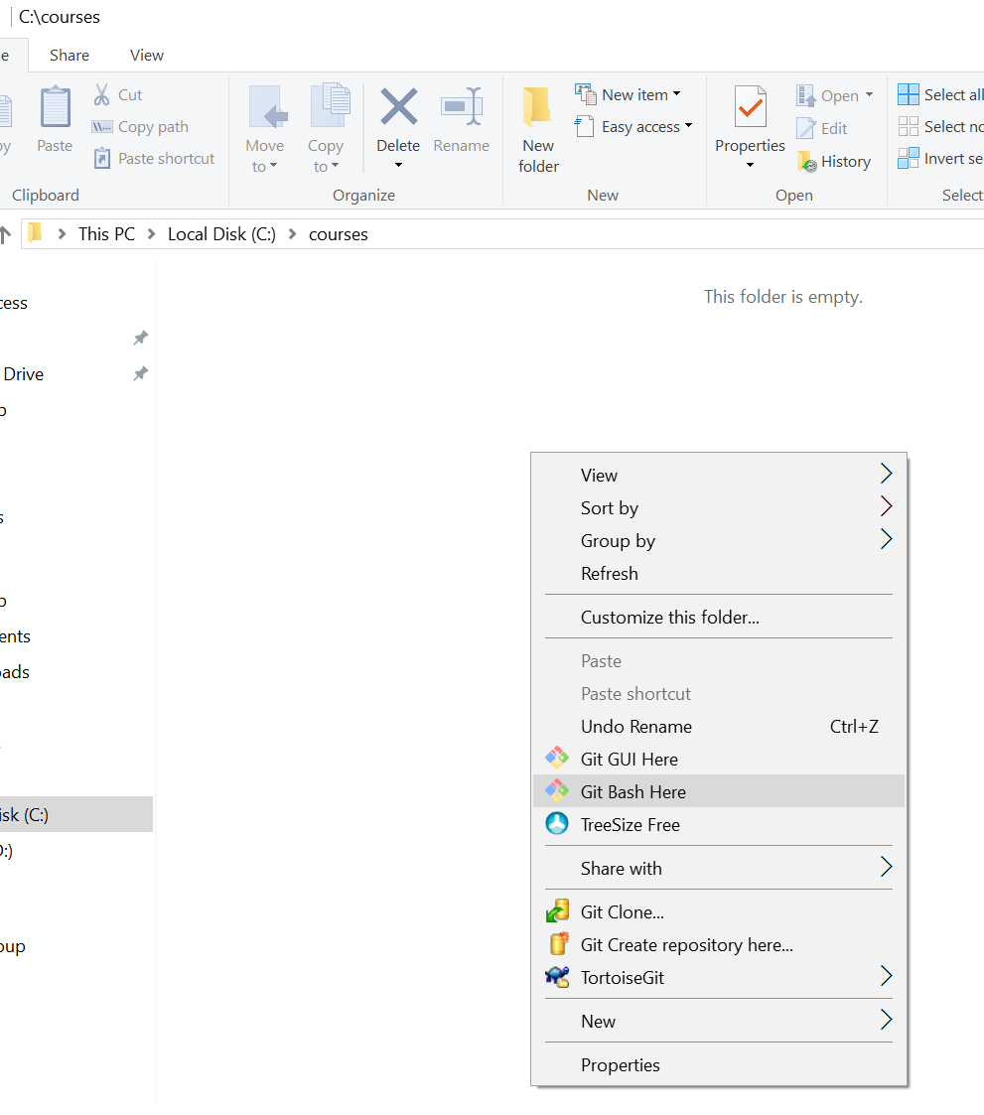
Setup GIT on Your Machine

Slide 6
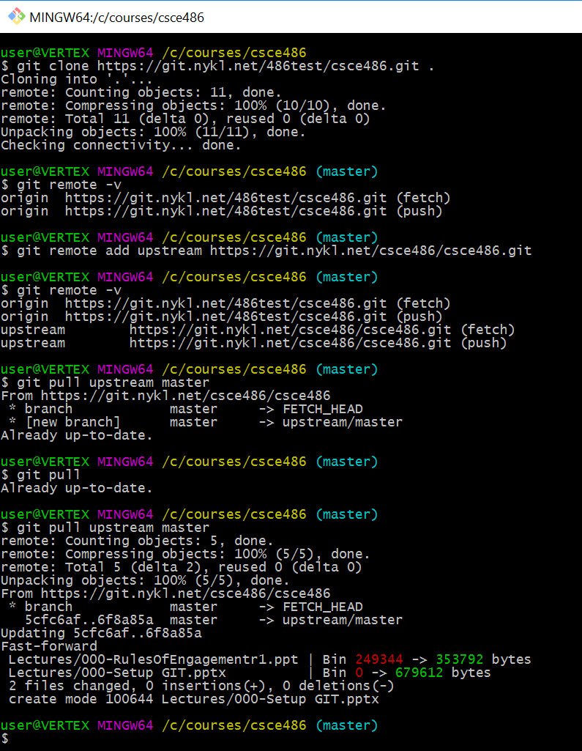
Your Username here
!!!Replace “486” with “593”!!!
Clones files from your forked repository to your local hard drive at /c/courses/csce486
Tells your local repository to add an upstream branch (pointing to the original repo from which you forked). This way, when I add new files to that repo, you can pull them into your forked repo.
View all remotes associated with your local repository
Pull latest files from the upstream (original, non-forked repo) into your local repo. You may then push these files to your forked repo on the server via git push.
At a later time, the professor will add content to repo. The student (you) can immediately get this new information by pulling from the upstream repository on the master branch.

Slide 7
What to Download & Install
GIT for Windows (latest 2.14.2) https://git-scm.com/download/win
Nice GUI Front End for GIT TortiseGIT https://tortoisegit.org/

